Slide 1




Slide 2

Unit 3 : Inter Process Communication and Synchronization
Dr. Abhijit and Mr. Deepak
School of Computer Science UPES, Dehradun
India

Slide 3
Unit 3: Inter-Process Communication
L1 | Inter Process Communication (IPC), IPC mechanisms: Shared Memory and Message Passing
L2 | Message Passing: Shared Memory, Pipes and Named pipes in Linux
L3 | Critical Section Problem, Race Condition,
L4 | Producer Consumer Problem, Solution to Critical section Problem: Hardware and Software Solutions,
L5 | Software Solutions: Semaphores: Counting semaphore, Binary semaphore,
L6 | Software Solutions: Monitors
L7 | Software Solutions: Algorithm 1, Algorithm 2,
L8 | Software Solutions: Algorithm 3/Peterson Solution, Bakery Algorithm
L9 | Classic process synchronization problems (case studies).

Slide 4
Unit 3: Inter-Process Communication
Lecture 1 | Inter Process Communication (IPC), IPC mechanisms: Shared Memory and Message Passing
Objective:
To discuss the communication mechanism among processes.
To explore different approach to achieve inter process communication

Slide 5
Interprocess Communication
Interprocess Communication (IPC) refers to the mechanisms provided by the operating system that allow processes to communicate with each other and synchronize their actions.
IPC is essential for the development of complex software systems where multiple processes need to work together and share data.
Here are some common IPC mechanisms:
i) Pipes
ii) Message Passing
iii) Shared Memory
iv) Socket
v) Semaphores
vi) Remote Procedure Call (RPC)

Slide 6
Interprocess Communication
Processes within a system may be independent or cooperating
Cooperating process can affect or be affected by other processes, including sharing data
Reasons for cooperating processes:
Information sharing
Computation speedup
Modularity
Convenience
Cooperating processes need interprocess communication (IPC)
Two models of IPC
Shared memory
Message passing

Slide 7
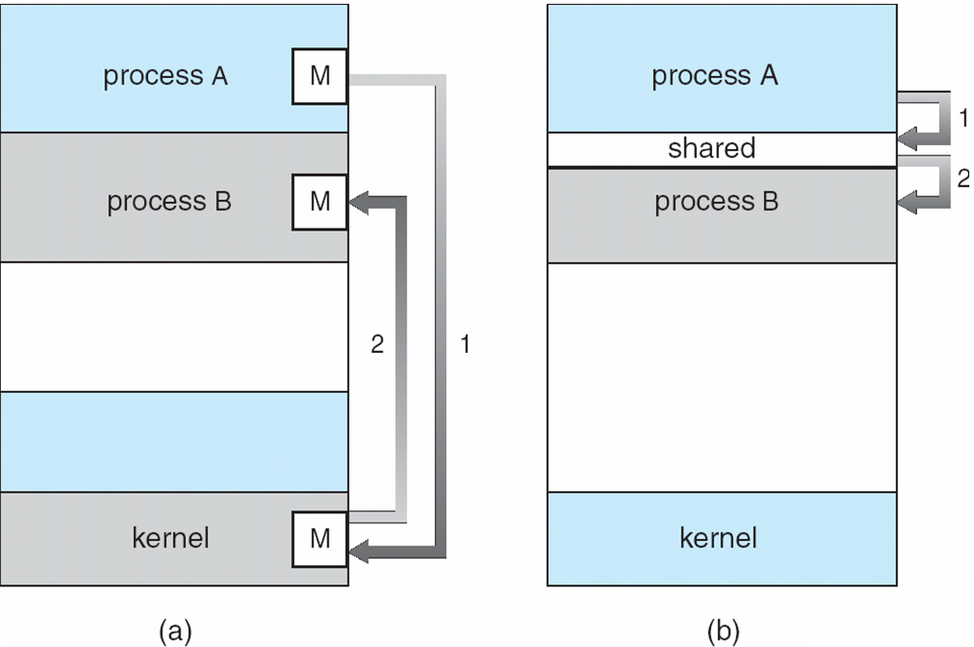
Communications Models
Fig 3.1 Interprocess communication model

Slide 8
Cooperating Processes
Independent process cannot affect or be affected by the execution of another process
Cooperating process can affect or be affected by the execution of another process
Advantages of process cooperation
Information sharing
Computation speed-up
Modularity
Convenience

Slide 9
Examples of Cooperating Processes
Web Servers: Multiple processes handle different client requests, sharing resources like memory and network connections.
Database Systems: Processes collaborate to manage transactions, maintain data consistency, and ensure concurrency control.
Distributed Systems: Processes running on different machines communicate and cooperate to perform distributed computations, share resources, and synchronize actions.
Operating Systems: System processes cooperate to manage hardware resources, perform I/O operations, and execute user programs

Slide 10
Benefits of Cooperating Processes
Cooperating processes offer numerous benefits, including resource sharing, computation speedup, modularity, information sharing, improved reliability, enhanced communication, flexibility, and scalability.
These advantages make cooperating processes essential in modern computing environments, particularly in multi-core, distributed, and real-time systems.

Slide 11

Lecture 2 | Message Passing: Shared Memory, Pipes and Named pipes in Linux
Objective:
To understand the concepts of Interprocess Communication through Message passing
To understand the concepts of Interprocess Communication through Shared memory
To understand the concepts of Interprocess Communication through Pipes

Slide 12
Interprocess Communication – Message Passing
Mechanism for processes to communicate and to synchronize their actions
Message system – processes communicate with each other without resorting to shared variables
IPC facility provides two operations:
send(message) – message size fixed or variable
receive(message)
If P and Q wish to communicate, they need to:
establish a communication link between them
exchange messages via send/receive
Implementation of communication link
physical (e.g., shared memory, hardware bus)
logical (e.g., logical properties)

Slide 13
Interprocess Communication – Message Passing
Examples of Message Passing in Different Contexts
1. Message Passing Interface (MPI) in Parallel ComputingMPI is a standardized and portable message-passing system designed for parallel computing.

Slide 14
#include <mpi.h>
#include <stdio.h>
int main(int argc, char** argv) {
MPI_Init(&argc, &argv); // Initialize MPI environment
int world_rank;
MPI_Comm_rank(MPI_COMM_WORLD, &world_rank); // Get rank of the current process
int world_size;
MPI_Comm_size(MPI_COMM_WORLD, &world_size); // Get total number of processes
int number;
if (world_rank == 0) {
// Process 0 initializes the number
number = -1;
// Process 0 sends the number to process 1
MPI_Send(&number, 1, MPI_INT, 1, 0, MPI_COMM_WORLD);
} else if (world_rank == 1) {
// Process 1 receives the number from process 0
MPI_Recv(&number, 1, MPI_INT, 0, 0, MPI_COMM_WORLD, MPI_STATUS_IGNORE);
// Process 1 prints the received number
printf("Process 1 received number %d from process 0\n", number);
}
MPI_Finalize(); // Finalize MPI environment
return 0; }
An example using MPI in C

Slide 15
Pipes
Acts as a conduit allowing two processes to communicate
Issues
Is communication unidirectional or bidirectional?
In the case of two-way communication, is it half or full-duplex?
Must there exist a relationship (i.e. parent-child) between the communicating processes?
Can the pipes be used over a network?

Slide 16
Ordinary Pipes
Ordinary Pipes allow communication in standard producer-consumer style
Producer writes to one end (the write-end of the pipe)
Consumer reads from the other end (the read-end of the pipe)
Ordinary pipes are therefore unidirectional
Require parent-child relationship between communicating processes

Slide 17
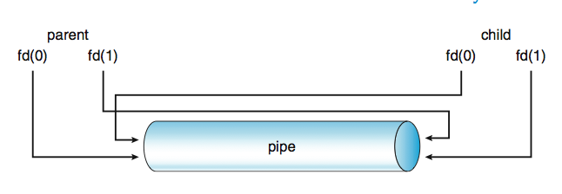
Ordinary Pipes
Fig: Ordinary Pipes

Slide 18
Named Pipes
Named Pipes are more powerful than ordinary pipes
Communication is bidirectional
No parent-child relationship is necessary between the communicating processes
Several processes can use the named pipe for communication
Provided on both UNIX and Windows systems

Slide 19
IPC mechanism in Pipes
#include <stdio.h>
#include <unistd.h>
int main() {
int fd[2];
pid_t pid;
char buffer[30];
pipe(fd);
pid = fork();
if (pid == 0) { // Child process
close(fd[0]); // Close unused read end
write(fd[1], "Hello, parent!", 14);
close(fd[1]); // Close write end
} else { // Parent process
close(fd[1]); // Close unused write end
read(fd[0], buffer, 14);
printf("%s\n", buffer);
close(fd[0]); // Close read end
}
return 0;
}

Slide 20
L3 | Critical Section Problem, Race Condition
Objectives:
To understand the concepts of Critical Section problem
To understand the race condition

Slide 21
Introduction
Concurrent access to shared data may result in data inconsistency
Maintaining data consistency requires mechanisms to ensure the orderly execution of cooperating processes
Example: The producer-consumer problem.
Suppose that we wanted to provide a solution to the consumer-producer problem that fills all the buffers. We can do so by having an integer count that keeps track of the number of full buffers. Initially, count is set to 0. It is incremented by the producer after it produces a new buffer and is decremented by the consumer after it consumes a buffer.
Race Condition:
A race condition occurs when multiple processes access and manipulate shared data concurrently, leading to unexpected results.
Example: Incrementing and decrementing a shared counter.

Slide 22
Race Condition
Race Condition
count++ could be implemented as register1 = count register1 = register1 + 1 count = register1
count-- could be implemented as register2 = count register2 = register2 - 1 count = register2
Consider this execution interleaving with “count = 5” initially:
S0: producer execute register1 = count {register1 = 5} S1: producer execute register1 = register1 + 1 {register1 = 6} S2: consumer execute register2 = count {register2 = 5} S3: consumer execute register2 = register2 - 1 {register2 = 4} S4: producer execute count = register1 {count = 6 } S5: consumer execute count = register2 {count = 4}

Slide 23

Producer
while (true) {
/* produce an item and put in nextProduced */
while (count == BUFFER_SIZE)
; // do nothing
buffer [in] = nextProduced;
in = (in + 1) % BUFFER_SIZE;
count++;
}

Slide 24
Consumer
while (true) {
while (count == 0)
; // do nothing
nextConsumed = buffer[out];
out = (out + 1) % BUFFER_SIZE;
count--;
/* consume the item in nextConsumed
}

Slide 25
Solution to Critical-Section Problem
1. Mutual Exclusion - If process P_{i} is executing in its critical section, then no other processes can be executing in their critical sections
2. Progress - If no process is executing in its critical section and there exist some processes that wish to enter their critical section, then the selection of the processes that will enter the critical section next cannot be postponed indefinitely
3. Bounded Waiting - A bound must exist on the number of times that other processes are allowed to enter their critical sections after a process has made a request to enter its critical section and before that request is granted
Assume that each process executes at a nonzero speed
No assumption concerning relative speed of the N processes

Slide 26
L4 | Producer Consumer Problem, Solution to Critical section Problem: Hardware and Software Solutions,
Objectives:
To understand the classical problems of Critical Section
To device and develop the solution related to classical problems of Critical Section

Slide 27
Peterson’s Solution
Two process solution
Assume that the LOAD and STORE instructions are atomic; that is, cannot be interrupted.
The two processes share two variables:
int turn;
Boolean flag[2]
The variable turn indicates whose turn it is to enter the critical section.
The flag array is used to indicate if a process is ready to enter the critical section. flag[i] = true implies that process P_{i} is ready!

Slide 28
Algorithm for Process P_{i}
do {
flag[i] = TRUE;
turn = j;
while (flag[j] && turn == j);
critical section
flag[i] = FALSE;
remainder section
} while (TRUE);

Slide 29
Synchronization Hardware
Many systems provide hardware support for critical section code
Uniprocessors – could disable interrupts
Currently running code would execute without preemption
Generally too inefficient on multiprocessor systems
Operating systems using this not broadly scalable
Modern machines provide special atomic hardware instructions
Atomic = non-interruptable
Either test memory word and set value
Or swap contents of two memory words

Slide 30
Solution to Critical-section Problem Using Locks
do {
acquire lock
critical section
release lock
remainder section
} while (TRUE);

Slide 31
TestAndSet Instruction
boolean TestAndSet (boolean *target)
{
boolean rv = *target;
*target = TRUE;
return rv:
}

Slide 32
Solution using TestAndSet
Shared boolean variable lock., initialized to false.
Solution:
do {
while ( TestAndSet (&lock ))
; // do nothing
// critical section
lock = FALSE;
// remainder section
} while (TRUE);

Slide 33
Swap Instruction
Definition:
void Swap (boolean *a, boolean *b)
{
boolean temp = *a;
*a = *b;
*b = temp:
}

Slide 34
Solution using Swap
Shared Boolean variable lock initialized to FALSE; Each process has a local Boolean variable key
Solution:
do {
key = TRUE;
while ( key == TRUE)
Swap (&lock, &key );
// critical section
lock = FALSE;
// remainder section
} while (TRUE);

Slide 35
Bounded-waiting Mutual Exclusion with TestandSet()
do {
waiting[i] = TRUE;
key = TRUE;
while (waiting[i] && key)
key = TestAndSet(&lock);
waiting[i] = FALSE;
// critical section
j = (i + 1) % n;
while ((j != i) && !waiting[j])
j = (j + 1) % n;
if (j == i)
lock = FALSE;
else
waiting[j] = FALSE;
// remainder section
} while (TRUE);

Slide 36
L5 | Software Solutions: Semaphores: Counting semaphore, Binary semaphore,
Objective
To understand the concept of semaphores and their types
To implement the different types of Semaphores

Slide 37
Semaphore
Semaphores are a synchronization mechanism used to control access to a common resource in concurrent programming and operating systems.
They are particularly useful for managing access to shared resources and ensuring that multiple processes or threads do not simultaneously access a critical section, leading to race conditions or inconsistent data.

Slide 38
Basic Operations: Semaphores
Support two atomic operations:
wait (P or down): Decreases the semaphore value. If the value is already 0, the process or thread is blocked until the semaphore value becomes positive.
signal (V or up): Increases the semaphore value. If there are any processes or threads waiting for the semaphore, one of them is unblocked.
wait(S):
while S <= 0:
// Busy wait (or block the process/thread)
S = S - 1
signal(S):
S = S + 1
Notes:
-

Slide 39
Semaphore as General Synchronization Tool
Counting semaphore – integer value can range over an unrestricted domain
Binary semaphore – integer value can range only between 0 and 1; can be simpler to implement
Also known as mutex locks
Can implement a counting semaphore S as a binary semaphore
Provides mutual exclusion
Semaphore mutex; // initialized to 1
do {
wait (mutex);
// Critical Section
signal (mutex);
// remainder section
} while (TRUE);

Slide 40
Semaphore Implementation
Must guarantee that no two processes can execute wait () and signal () on the same semaphore at the same time
Thus, implementation becomes the critical section problem where the wait and signal code are placed in the crtical section.
Could now have busy waiting in critical section implementation
But implementation code is short
Little busy waiting if critical section rarely occupied
Note that applications may spend lots of time in critical sections and therefore this is not a good solution.

Slide 41
Semaphore Implementation with no Busy waiting
With each semaphore there is an associated waiting queue. Each entry in a waiting queue has two data items:
value (of type integer)
pointer to next record in the list
Two operations:
block – place the process invoking the operation on the appropriate waiting queue.
wakeup – remove one of processes in the waiting queue and place it in the ready queue.

Slide 42
Semaphore Implementation with no Busy waiting (Cont.)
Implementation of wait:
wait(semaphore *S) {
S->value--;
if (S->value < 0) {
add this process to S->list;
block();
}
}
Implementation of signal:
signal(semaphore *S) {
S->value++;
if (S->value <= 0) {
remove a process P from S->list;
wakeup(P);
}
}

Slide 43
Use of Semaphore: Deadlock and Starvation
Deadlock – two or more processes are waiting indefinitely for an event that can be caused by only one of the waiting processes
Let S and Q be two semaphores initialized to 1
P₀ P₁
wait (S); wait (Q);
wait (Q); wait (S);
. .
. .
. .
signal (S); signal (Q);
signal (Q); signal (S);
Starvation – indefinite blocking. A process may never be removed from the semaphore queue in which it is suspended
Priority Inversion - Scheduling problem when lower-priority process holds a lock needed by higher-priority process

Slide 44
L6 | Software Solutions: Monitors
Objective:
To explore the software solutions using Monitors

Slide 45
Monitors
A high-level abstraction that provides a convenient and effective mechanism for process synchronization
Only one process may be active within the monitor at a time
monitor monitor-name
{
// shared variable declarations
procedure P1 (…) { …. }
…
procedure Pn (…) {……}
Initialization code ( ….) { … }
…
}
}

Slide 46
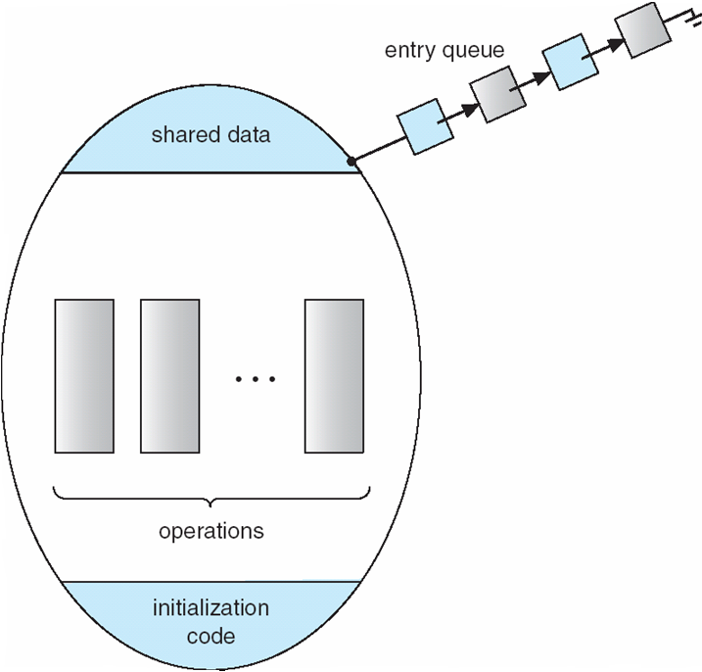
Schematic view of a Monitor
Fig: Schematic View of Monitor

Slide 47
Condition Variables
condition x, y;
Two operations on a condition variable:
x.wait () – a process that invokes the operation is suspended.
x.signal () – resumes one of processes (if any) that invoked x.wait ()

Slide 48
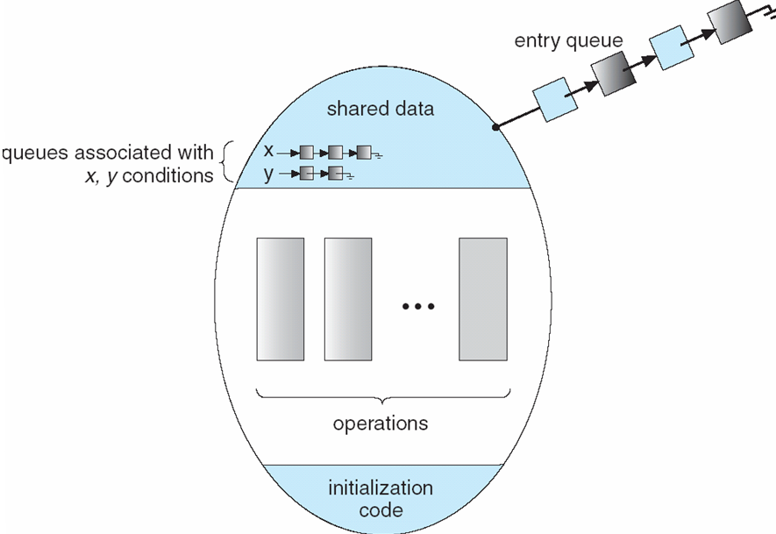
Monitor with Condition Variables

Slide 49
Solution to Dining Philosophers using Monitor
monitor DP
{
enum { THINKING; HUNGRY, EATING) state [5] ;
condition self [5];
void pickup (int i) {
state[i] = HUNGRY;
test(i);
if (state[i] != EATING) self [i].wait;
}
void putdown (int i) {
state[i] = THINKING;
// test left and right neighbors
test((i + 4) % 5);
test((i + 1) % 5);
}

Slide 50
Solution to Dining Philosophers (cont)
void test (int i) {
if ( (state[(i + 4) % 5] != EATING) &&
(state[i] == HUNGRY) &&
(state[(i + 1) % 5] != EATING) ) {
state[i] = EATING ;
self[i].signal () ;
}
}
initialization_code() {
for (int i = 0; i < 5; i++)
state[i] = THINKING;
}
}

Slide 51
Solution to Dining Philosophers (cont)
Each philosopher I invokes the operations pickup()
and putdown() in the following sequence:
DiningPhilosophters.pickup (i);
EAT
DiningPhilosophers.putdown (i);

Slide 52
Monitor Implementation Using Semaphores
Variables
semaphore mutex; // (initially = 1)
semaphore next; // (initially = 0)
int next-count = 0;
Each procedure F will be replaced by
wait(mutex);
…
body of F;
…
if (next_count > 0)
signal(next)
else
signal(mutex);
Mutual exclusion within a monitor is ensured.

Slide 53
Monitor Implementation
For each condition variable x, we have:
semaphore x_sem; // (initially = 0)
int x-count = 0;
The operation x.wait can be implemented as:
x-count++;
if (next_count > 0)
signal(next);
else
signal(mutex);
wait(x_sem);
x-count--;

Slide 54
Monitor Implementation
The operation x.signal can be implemented as:
if (x-count > 0) {
next_count++;
signal(x_sem);
wait(next);
next_count--;
}

Slide 55
A Monitor to Allocate Single Resource
monitor ResourceAllocator
{
boolean busy;
condition x;
void acquire(int time) {
if (busy)
x.wait(time);
busy = TRUE;
}
void release() {
busy = FALSE;
x.signal();
}
initialization code() {
busy = FALSE;
}
}

Slide 56
L7 & 8 | Software Solutions: Peterson Solution, Bakery Algorithm
Objective:
To understand the software solutions using various algorithms

Slide 57
Peterson’s Solution
Two-process solution
Assumptions:
LOAD and STORE instructions are atomic (cannot be interrupted).
Shared variables:
int turn;
boolean flag[2];
Explanation:
turn indicates whose turn it is to enter the critical section.
flag array indicates if a process is ready to enter the critical section. flag[i] = true implies that process Pi is ready.
Algorithm for Process Pi
do {
flag[i] = true;
turn = j;
while (flag[j] && turn == j);
// Critical section
flag[i] = false;
// Remainder section
} while (true);

Slide 58
Bakery Algorithm
N-process solution
Assumptions:
The integers are assumed to be unbounded.
Shared variables:
boolean choosing[N];
int number[N];
Explanation:
choosing[i] indicates if process Pi is in the process of choosing a number.
number[i] holds the number chosen by process Pi. A higher number indicates a higher priority.

Slide 59
Bakery Algorithm Cont..
do {
choosing[i] = true;
number[i] = 1 + max(number[0], number[1], ..., number[N-1]);
choosing[i] = false;
for (j = 0; j < N; j++) {
while (choosing[j]);
while ((number[j] != 0) && ((number[j], j) < (number[i], i)));
}
// Critical section
number[i] = 0;
// Remainder section
} while (true);

Slide 60
Pthreads Synchronization
Pthreads API is OS-independent
It provides:
mutex locks
condition variables
Non-portable extensions include:
read-write locks
spin locks

Slide 61
Serializability
Consider two data items A and B
Consider Transactions T₀ and T₁
Execute T₀, T₁ atomically
Execution sequence called schedule
Atomically executed transaction order called serial schedule
For N transactions, there are N! valid serial schedules

Slide 62
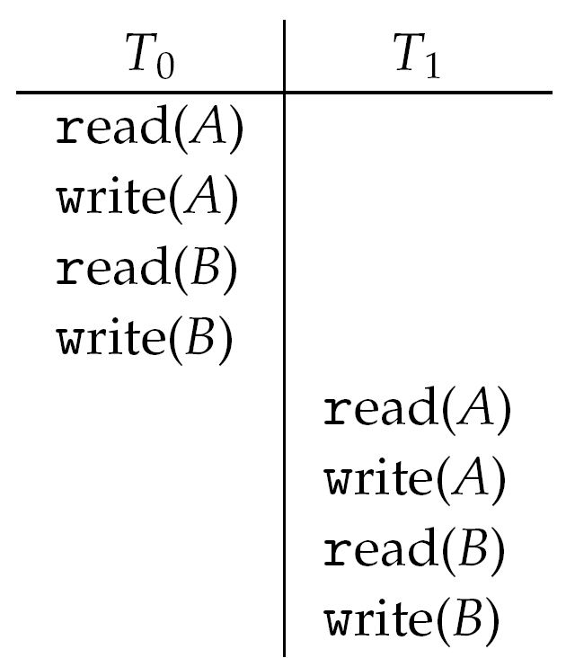
Schedule 1: T₀ then T₁

Slide 63
Nonserial Schedule
Nonserial schedule allows overlapped execute
Resulting execution not necessarily incorrect
Consider schedule S, operations O_{i}, O_{j}
Conflict if access same data item, with at least one write
If O_{i}, O_{j} consecutive and operations of different transactions & O_{i} and O_{j} don’t conflict
Then S’ with swapped order O_{j} O_{i} equivalent to S
If S can become S’ via swapping nonconflicting operations
S is conflict serializable

Slide 64
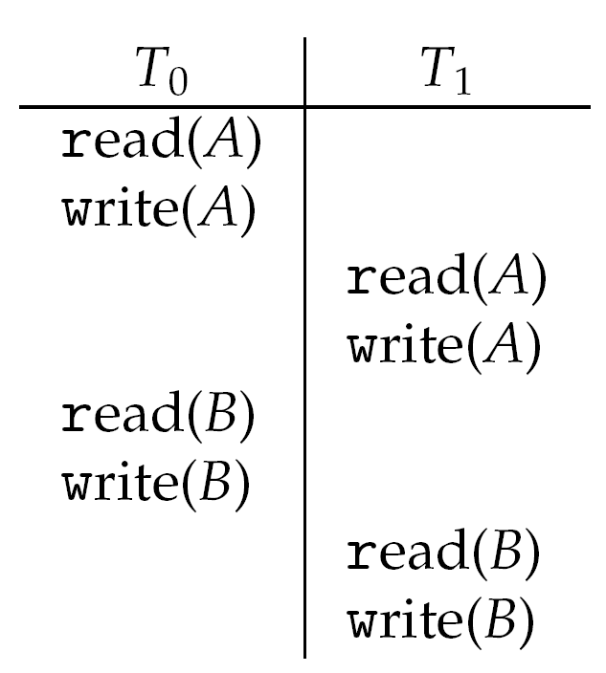
Schedule 2: Concurrent Serializable Schedule

Slide 65
Locking Protocol
Ensure serializability by associating lock with each data item
Follow locking protocol for access control
Locks
Shared – T_{i} has shared-mode lock (S) on item Q, T_{i} can read Q but not write Q
Exclusive – Ti has exclusive-mode lock (X) on Q, T_{i} can read and write Q
Require every transaction on item Q acquire appropriate lock
If lock already held, new request may have to wait
Similar to readers-writers algorithm

Slide 66
Two-phase Locking Protocol
Generally ensures conflict serializability
Each transaction issues lock and unlock requests in two phases
Growing – obtaining locks
Shrinking – releasing locks
Does not prevent deadlock

Slide 67
Timestamp-based Protocols
Select order among transactions in advance – timestamp-ordering
Transaction T_{i} associated with timestamp TS(T_{i}) before T_{i} starts
TS(T_{i}) < TS(T_{j}) if Ti entered system before T_{j}
TS can be generated from system clock or as logical counter incremented at each entry of transaction
Timestamps determine serializability order
If TS(T_{i}) < TS(T_{j}), system must ensure produced schedule equivalent to serial schedule where T_{i} appears before T_{j}

Slide 68
Timestamp-based Protocol Implementation
Data item Q gets two timestamps
W-timestamp(Q) – largest timestamp of any transaction that executed write(Q) successfully
R-timestamp(Q) – largest timestamp of successful read(Q)
Updated whenever read(Q) or write(Q) executed
Timestamp-ordering protocol assures any conflicting read and write executed in timestamp order
Suppose Ti executes read(Q)
If TS(T_{i}) < W-timestamp(Q), Ti needs to read value of Q that was already overwritten
read operation rejected and T_{i} rolled back
If TS(T_{i}) ≥ W-timestamp(Q)
read executed, R-timestamp(Q) set to max(R-timestamp(Q), TS(T_{i}))

Slide 69
Timestamp-ordering Protocol
Suppose Ti executes write(Q)
If TS(T_{i}) < R-timestamp(Q), value Q produced by T_{i} was needed previously and T_{i} assumed it would never be produced
Write operation rejected, T_{i} rolled back
If TS(T_{i}) < W-tiimestamp(Q), T_{i} attempting to write obsolete value of Q
Write operation rejected and T_{i} rolled back
Otherwise, write executed
Any rolled back transaction T_{i} is assigned new timestamp and restarted
Algorithm ensures conflict serializability and freedom from deadlock

Slide 70
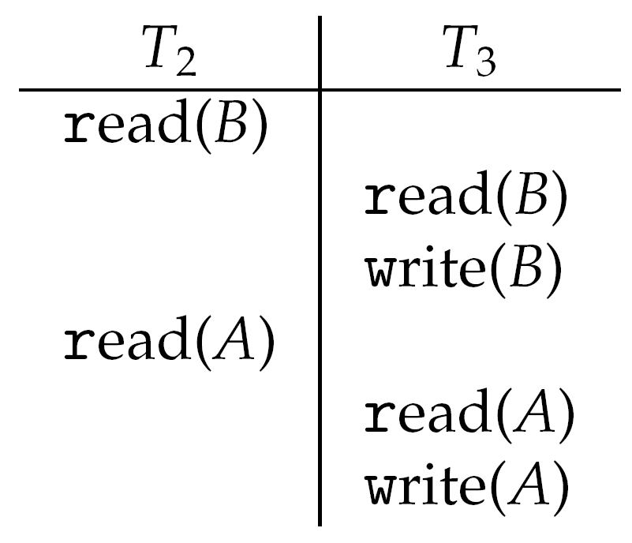
Schedule Possible Under Timestamp Protocol

Slide 71
L9 | Classic process synchronization problems (case studies)
Objective:
To understand the classic Synchronization examples and case studies

Slide 72
Synchronization Examples
Solaris
Windows XP
Linux
Pthreads

Slide 73
Solaris Synchronization
Implements a variety of locks to support multitasking, multithreading (including real-time threads), and multiprocessing
Uses adaptive mutexes for efficiency when protecting data from short code segments
Uses condition variables and readers-writers locks when longer sections of code need access to data
Uses turnstiles to order the list of threads waiting to acquire either an adaptive mutex or reader-writer lock

Slide 74
Windows XP Synchronization
Uses interrupt masks to protect access to global resources on uniprocessor systems
Uses spinlocks on multiprocessor systems
Also provides dispatcher objects which may act as either mutexes and semaphores
Dispatcher objects may also provide events
An event acts much like a condition variable

Slide 75
Linux Synchronization
Linux:
Prior to kernel Version 2.6, disables interrupts to implement short critical sections
Version 2.6 and later, fully preemptive
Linux provides:
semaphores
spin locks

Slide 76
Classical Problems of Synchronization
Bounded-Buffer Problem
Readers and Writers Problem
Dining-Philosophers Problem

Slide 77
Bounded-Buffer Problem
N buffers, each can hold one item
Semaphore mutex initialized to the value 1
Semaphore full initialized to the value 0
Semaphore empty initialized to the value N.

Slide 78
Bounded Buffer Problem (Cont.)
The structure of the producer process
do {
// produce an item in nextp
wait (empty);
wait (mutex);
// add the item to the buffer
signal (mutex);
signal (full);
} while (TRUE);

Slide 79
Bounded Buffer Problem (Cont.)
The structure of the consumer process
do {
wait (full);
wait (mutex);
// remove an item from buffer to nextc
signal (mutex);
signal (empty);
// consume the item in nextc
} while (TRUE);

Slide 80
Readers-Writers Problem
A data set is shared among a number of concurrent processes
Readers – only read the data set; they do not perform any updates
Writers – can both read and write
Problem – allow multiple readers to read at the same time. Only one single writer can access the shared data at the same time
Shared Data
Data set
Semaphore mutex initialized to 1
Semaphore wrt initialized to 1
Integer readcount initialized to 0

Slide 81
Readers-Writers Problem (Cont.)
The structure of a writer process
do {
wait (wrt) ;
// writing is performed
signal (wrt) ;
} while (TRUE);

Slide 82
Readers-Writers Problem (Cont.)
The structure of a reader process
do {
wait (mutex) ;
readcount ++ ;
if (readcount == 1)
wait (wrt) ;
signal (mutex)
// reading is performed
wait (mutex) ;
readcount - - ;
if (readcount == 0)
signal (wrt) ;
signal (mutex) ;
} while (TRUE);

Slide 83

Dining-Philosophers Problem
Shared data
Bowl of rice (data set)
Semaphore chopstick [5] initialized to 1

Slide 84
Dining-Philosophers Problem (Cont.)
The structure of Philosopher i:
do {
wait ( chopstick[i] );
wait ( chopStick[ (i + 1) % 5] );
// eat
signal ( chopstick[i] );
signal (chopstick[ (i + 1) % 5] );
// think
} while (TRUE);

Slide 85
Problems with Semaphores
Incorrect use of semaphore operations:
signal (mutex) …. wait (mutex)
wait (mutex) … wait (mutex)
Omitting of wait (mutex) or signal (mutex) (or both)

Slide 86
Multiple-Choice Questions (MCQs)
1) Which of the following is NOT a mechanism for Inter-Process Communication (IPC)?
A) Shared Memory
B) Message Passing
C) Pipelining
D) Remote Procedure Calls (RPC)
2) In message passing, what is the function of the send(message) operation?
A) To receive a message from another process
B) To send a message to another process
C) To create a shared memory space
D) To initialize message buffers
3) What is a race condition?
A) A condition where processes race to complete tasks
B) A scenario where two processes compete for CPU time
C) A condition where the outcome depends on the non-deterministic ordering of processes
D) A situation where processes run in a round-robin manner
4) Which of the following is NOT a requirement for the critical-section problem solution?
A) Mutual Exclusion
B) Progress
C) Bounded Waiting
D) Unbounded Execution
5) What is the primary role of a semaphore in process synchronization?
A) To allocate CPU time to processes
B) To manage memory allocation
C) To ensure mutual exclusion and synchronization
D) To handle I/O operations
6) Which synchronization mechanism uses wait() and signal() operations?
A) Locks
B) Semaphores
C) Monitors
D) Barriers
Notes:
Answers:
C) Pipelining
B) To send a message to another process
C) A condition where the outcome depends on the non-deterministic ordering of processes
D) Unbounded Execution
C) To ensure mutual exclusion and synchronization
B) Semaphores
B) The process allowed to enter the critical section next
B) A high-level synchronization abstraction
C) Dining Philosophers Problem
B) Solaris

Slide 87
Multiple-Choice Questions (MCQs)
7) In Peterson’s solution for the critical-section problem, what does the turn variable signify?
A) The process currently in the critical section
B) The process allowed to enter the critical section next
C) The number of processes waiting to enter the critical section
D) The priority of processes
8) What is a monitor in the context of process synchronization?
A) A low-level synchronization primitive
B) A high-level synchronization abstraction
C) A type of semaphore
D) A hardware-based synchronization mechanism
9) Which of the following problems is an example of a classic synchronization problem?
A) Memory Allocation Problem
B) Process Scheduling Problem
C) Dining Philosophers Problem
D) Disk Scheduling Problem
10) Which of the following operating systems uses adaptive mutexes for synchronization?
A) Windows XP
B) Solaris
C) Linux
D) MacOS
Notes:
Answers:
C) Pipelining
B) To send a message to another process
C) A condition where the outcome depends on the non-deterministic ordering of processes
D) Unbounded Execution
C) To ensure mutual exclusion and synchronization
B) Semaphores
B) The process allowed to enter the critical section next
B) A high-level synchronization abstraction
C) Dining Philosophers Problem
B) Solaris

Slide 88
Answers:
C) Pipelining
B) To send a message to another process
C) A condition where the outcome depends on the non-deterministic ordering of processes
D) Unbounded Execution
C) To ensure mutual exclusion and synchronization
B) Semaphores
B) The process allowed to enter the critical section next
B) A high-level synchronization abstraction
C) Dining Philosophers Problem
B) Solaris

Slide 89

Thank You

